Slide 1
Hackathon AIS’19
Measurement group
DNS over HTTPS/TLS team
Team name: Just DoH it!
Kampala, 19-20 June 2019

Slide 3
Problem statement
Traditional DNS queries and responses are sent over UDP or TCP without encryption.
Vulnerable to eavesdropping and spoofing. Responses from recursive resolvers to clients are the most vulnerable to undesired/malicious changes, while communications between recursive resolvers and authoritative NS often incorporate additional protection such as DNSSEC.
How to protect/secure clients to resolvers communication???

Slide 4
Motivation
Run your own DoH and/or DoT server
Increase user privacy and security by preventing eavesdropping and manipulation of DNS data.

Slide 5
REQUIREMENTS
HTTP Server: Nginx for example
Certbot/Let’s Encrypt to generate SSL certificates and integrate to the HTTP server.
A resolver: Unbound is simple and perfect!
Firewall rules for security: iptables/firewalld
a browser: Firefox is fine!
Wireshark or tcpdump to analyse the traffic
Be patient and open your eyes!

Slide 6
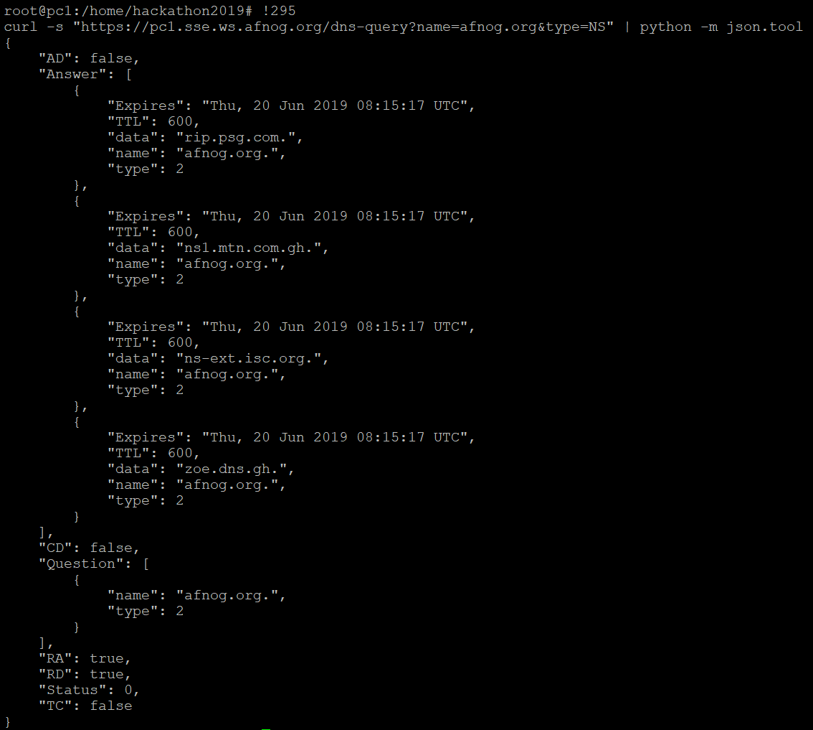
Test your DoH server locally

Slide 7
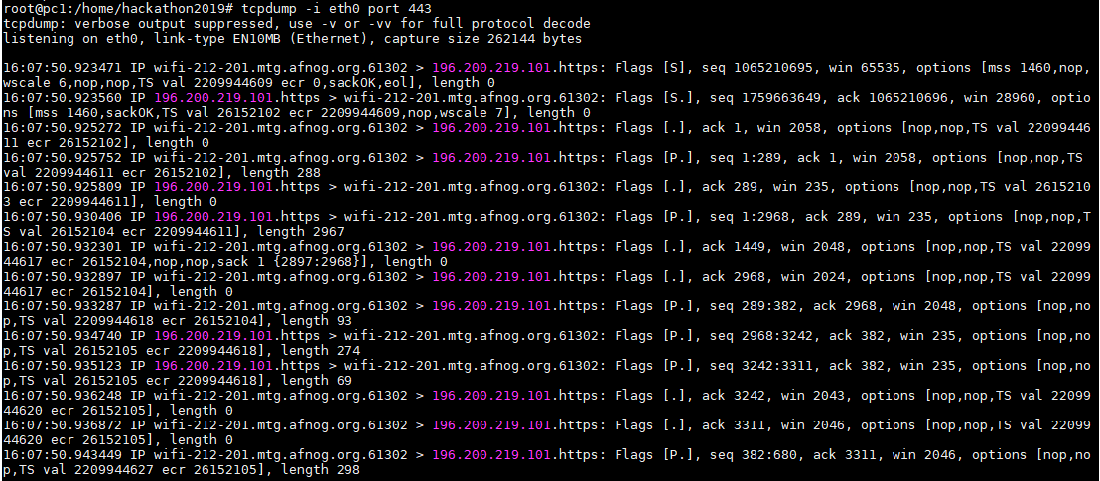
Tcpdump on SSL port

Slide 8
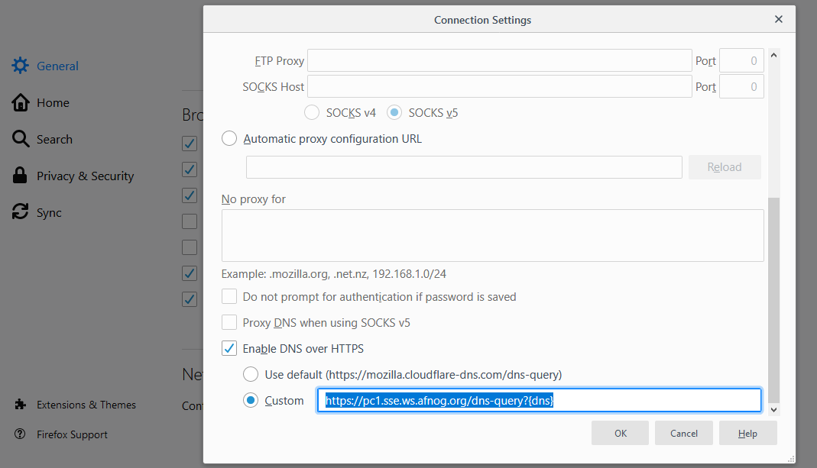
Use your DoH using your client browser

Slide 9
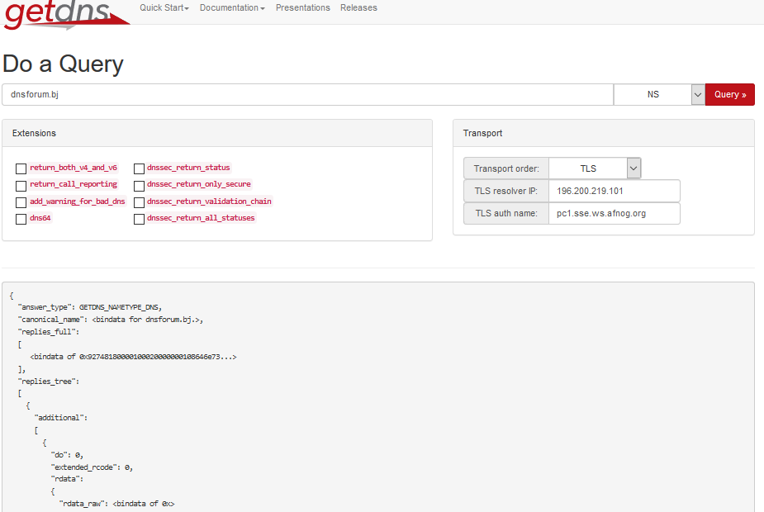
Test your DoT server using getdnsapi Answer should be "status": GETDNS_RESPSTATUS_GOOD

Slide 10
Future improvements
Implement a Windows client like Stubby so that the entire client OS DNS requests will be secured, not only the browser requests.
Test on Android clients.
…

Slide 11
Documentation
Tutorial 1 to setup DoH: https://www.bentasker.co.uk/documentation/linux/407-building-and-running-your-own-dns-over-https-server
Tutorial 2 to setup DoH: https://www.aaflalo.me/2018/10/tutorial-setup-dns-over-https-server/
Tutorial to setup DoT: https://www.aaflalo.me/2019/03/dns-over-tls/
Test DNS over TLS: https://getdnsapi.net/query/

Slide 12
Typos in documentation
In Tutorial 1 to setup DoH, installing Nginx, /etc/nginx/conf.d/doh.conf: “listen 80;” instead of “listen 80”
In DoT configuration, /etc/nginx/nginx.conf :
Append “include /etc/nginx/streams/*;” instead of
stream {
include /etc/nginx/streams/*;
}

